Slide 1

Atlassian JIRA for Scrum
RAHUL GUJAR

Slide 2
Brief Agenda
What is JIRA
JIRA Agile
Creating an Agile Project
Creating Epics / Stories / Sub-Tasks
Estimation (Story Points)
Basic Agile Board
Reporting
Sprint Burndown Charts
Sprint Report
Epic Burndown Charts
Retrospectives using Confluence
Kanban Projects
Testing Projects
Filters
JIRA Administration (Basics for Scrum Project)
Defining Issue Types
Defining Custom fields
Defining Workflows & Statuses
Dashboard Filters
Jira Add-Ons
Release Notes using Confluence

Slide 3
What is JIRA
JIRA is a tool developed by an Australian company called Atlassian
Lets you track everything on a project [prioritize, assign, track & report on Issues]
Helps improve productivity and quality
Better team work, visibility and predictability
JIRA Agile
Add on functionality to JIRA
Provides for:
Agile Board
Kanban Board
Reports (Burndown/Burnup Charts, CFD and more..)
Track Sprints across teams
Highly Customizable to suit organizational practices

Slide 4

Who is using JIRA
Over 60,000 companies rely on Atlassian to improve software development, project management, collaboration, and code quality.

Slide 5
Setting a Jira Cloud instance

Slide 6
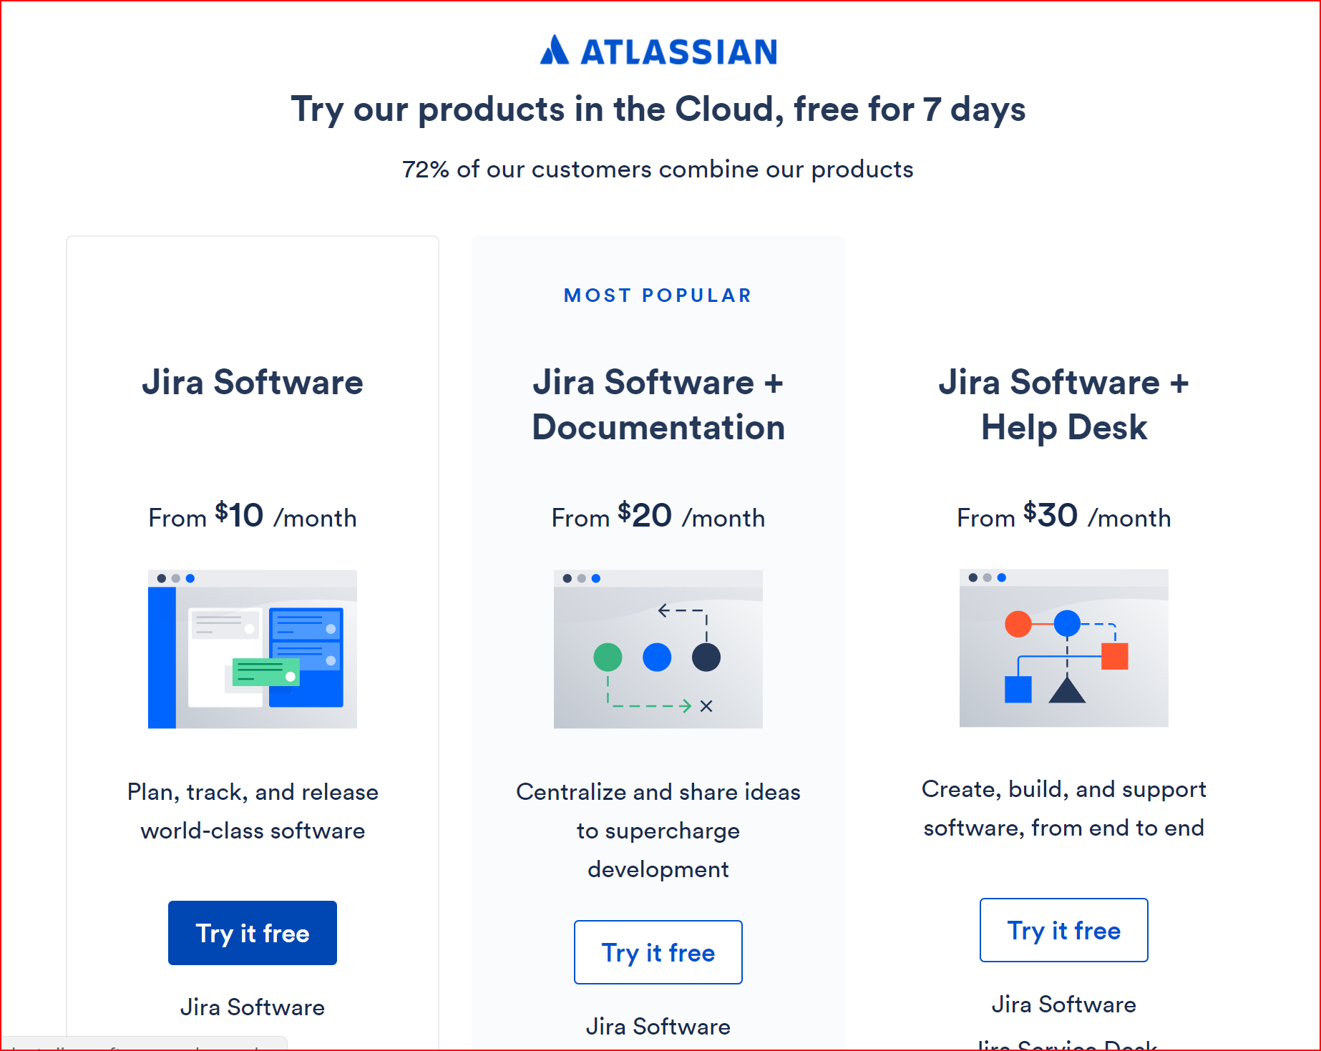
Jira Cloud Setup

Slide 7
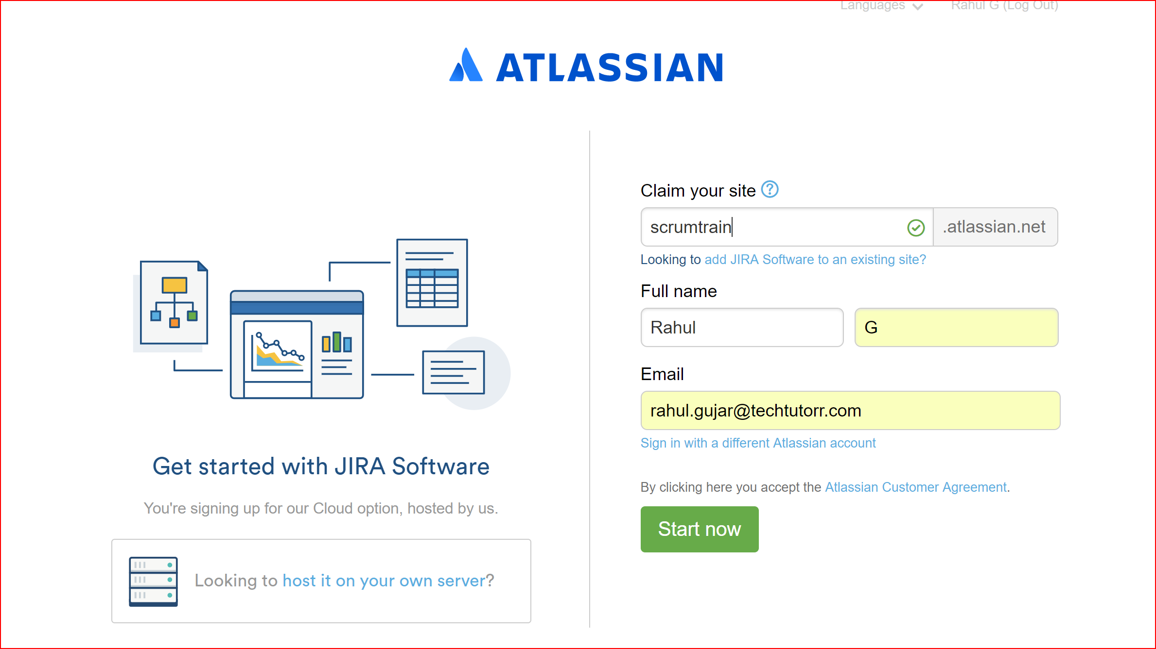

Slide 8
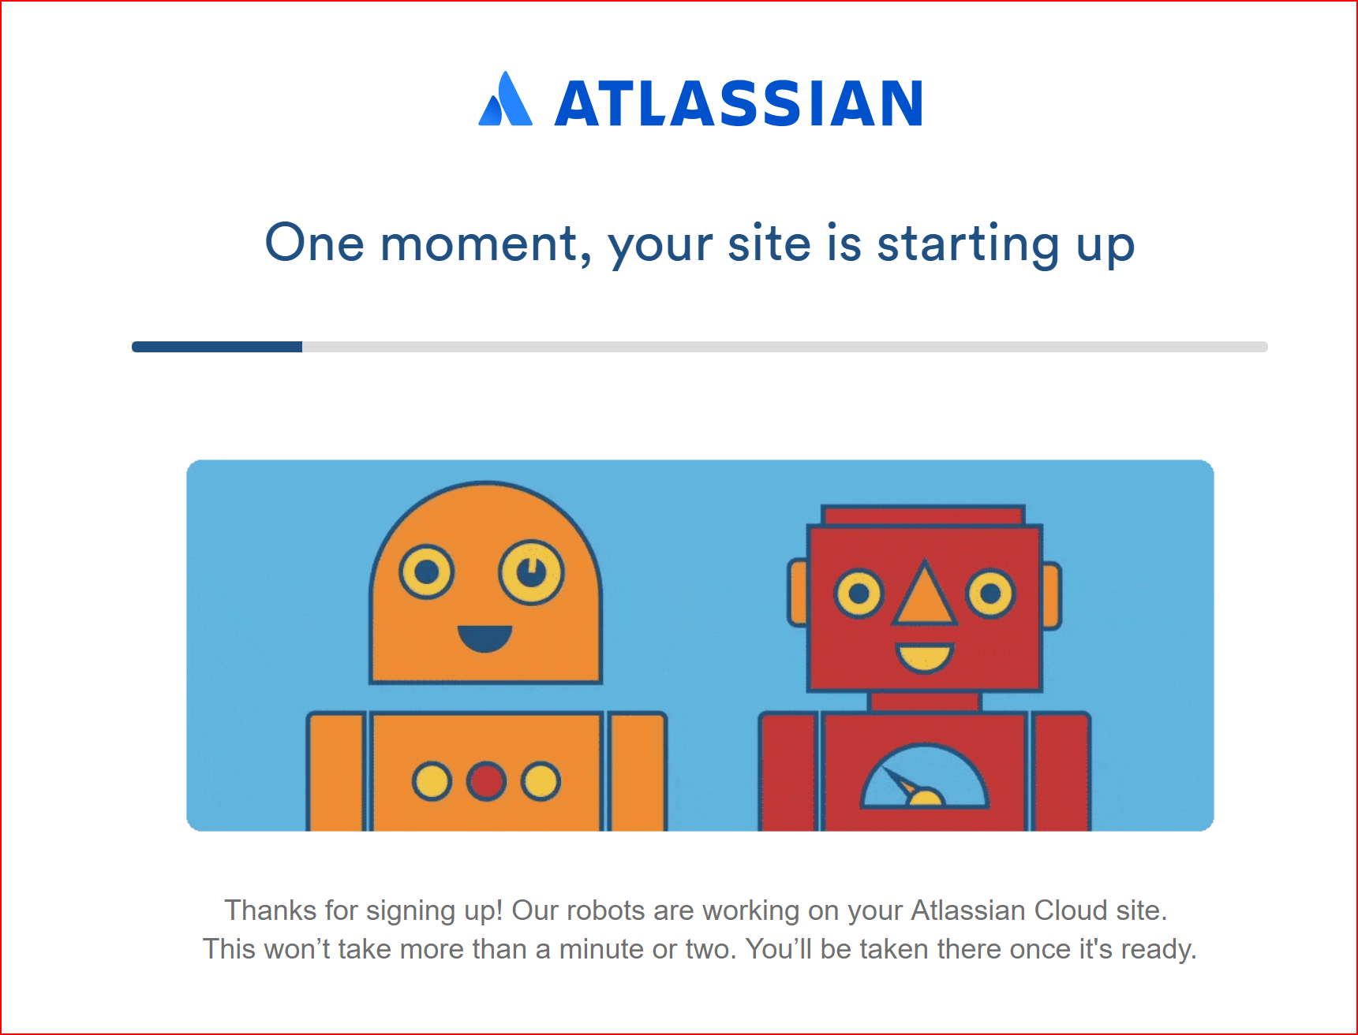

Slide 9


Slide 10
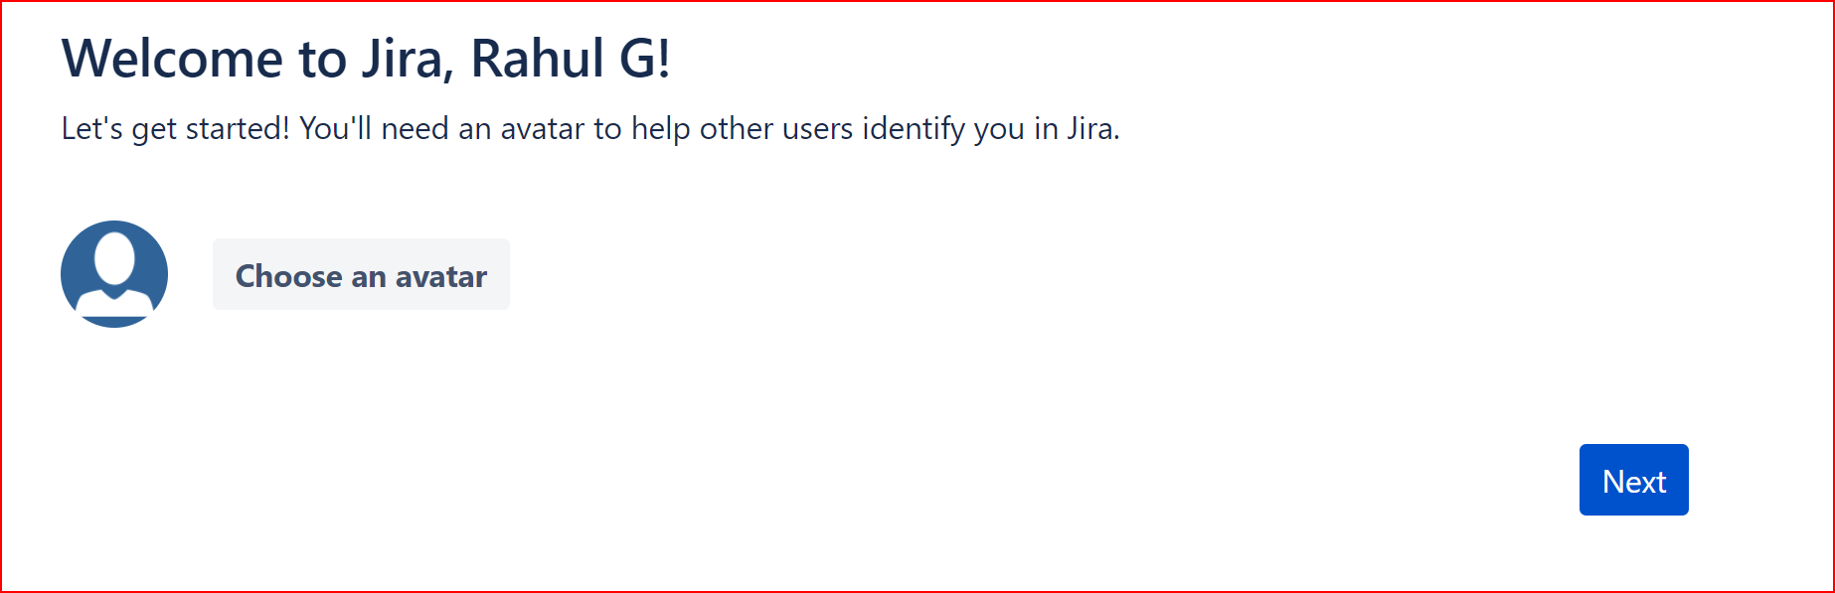
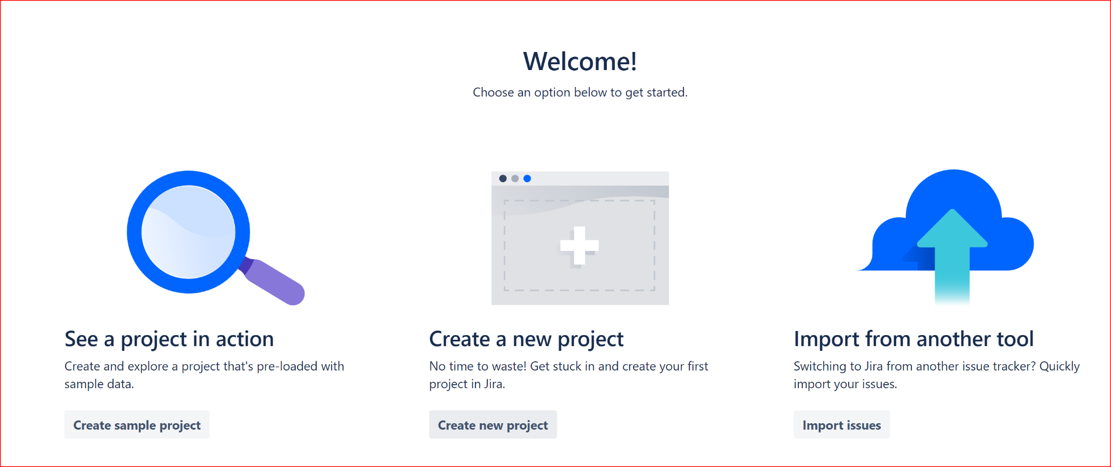

Slide 11
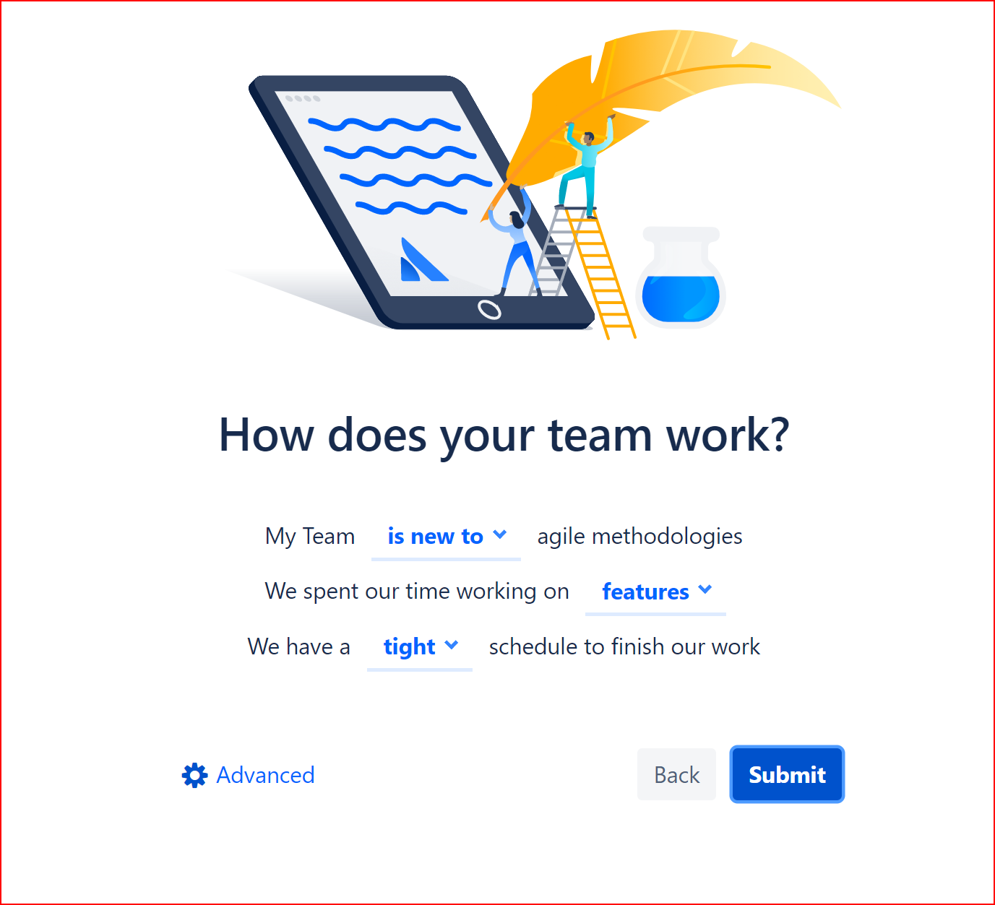

Slide 12
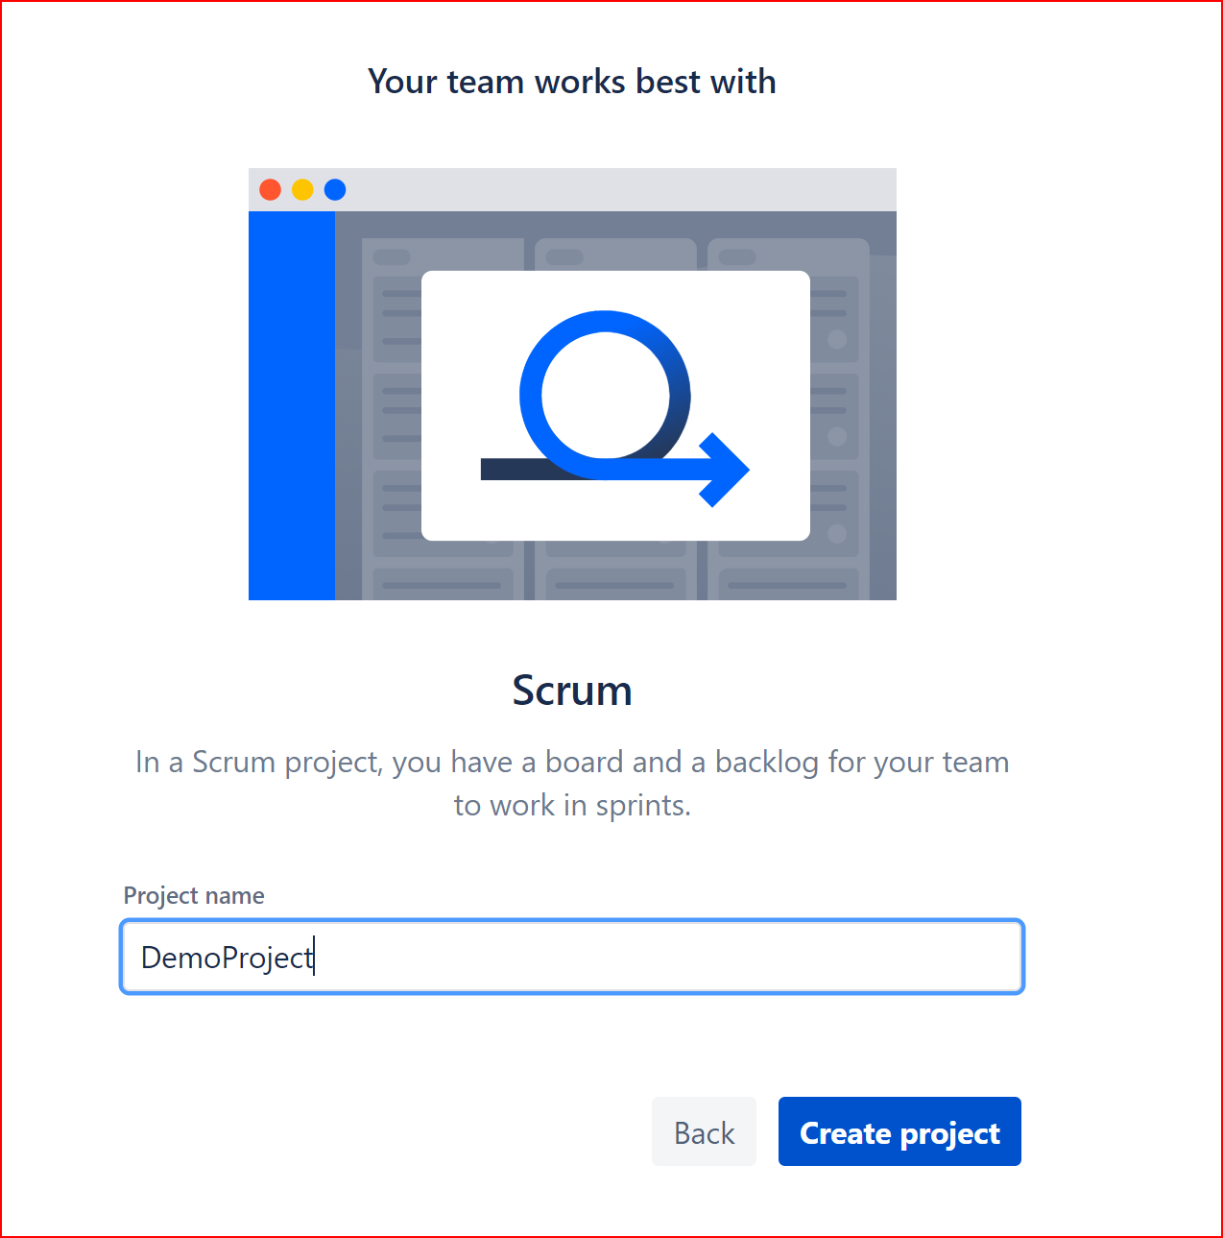

Slide 13
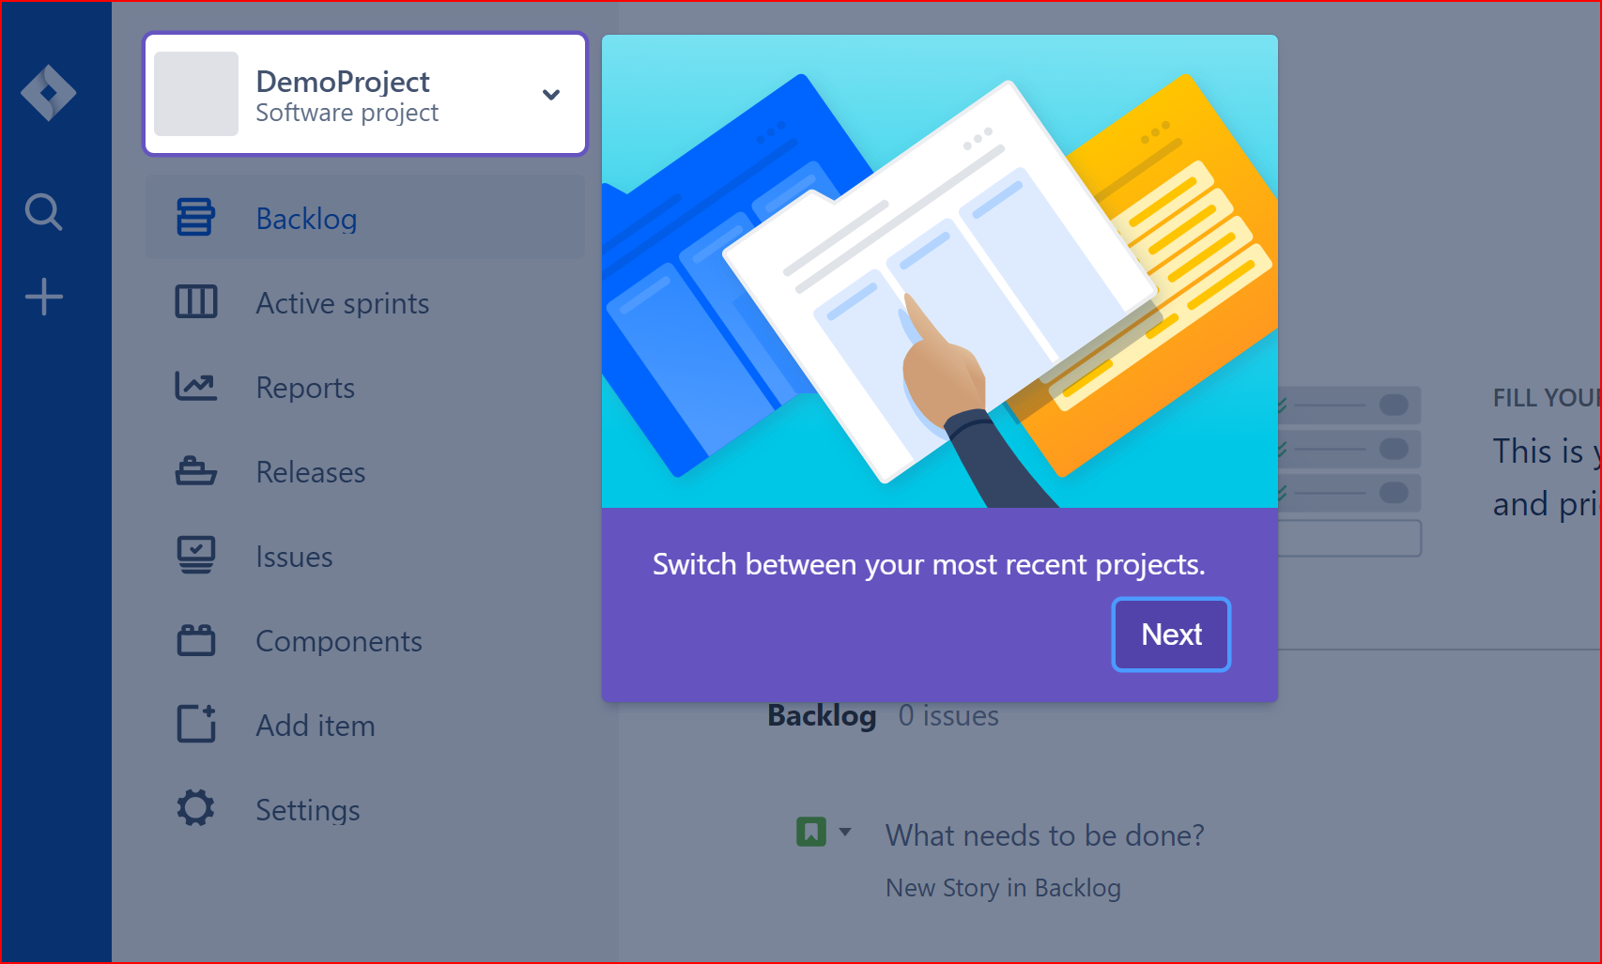

Slide 14
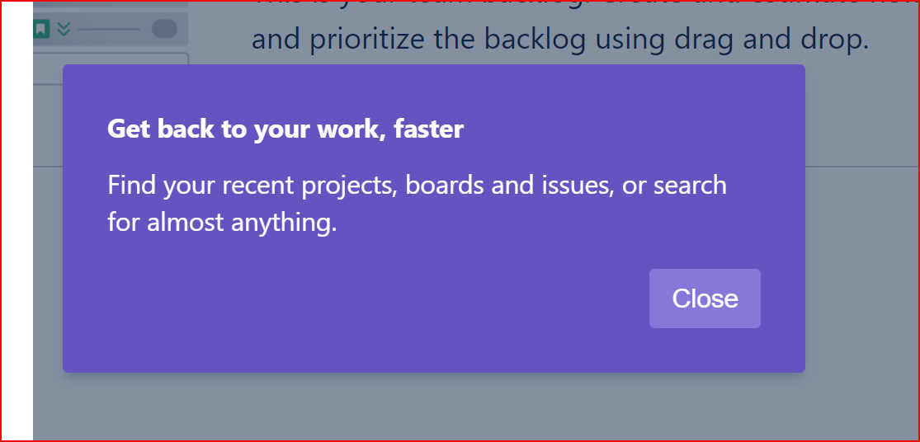

Slide 15
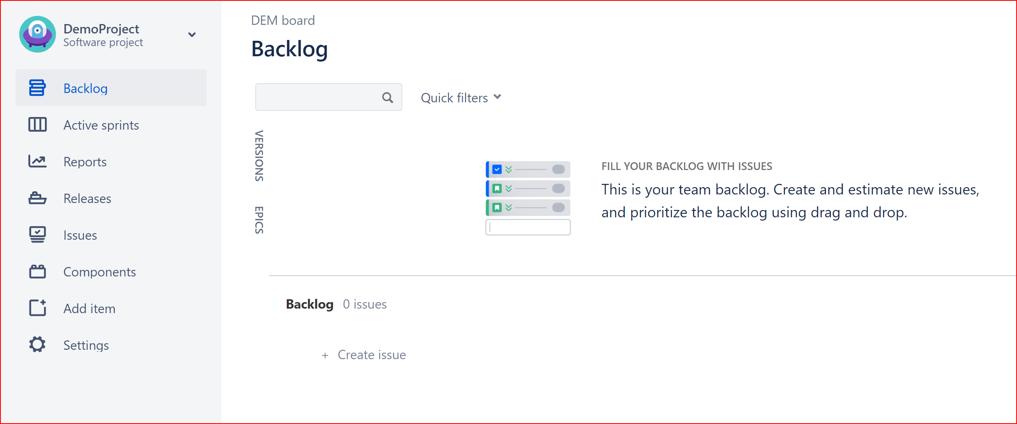

Slide 16
JIRA AGILE
Creating an Agile Project
Creating PBI
Creating Epics / Stories / Sub-Tasks
Estimation (Story Points)
Basic Agile Board

Slide 17
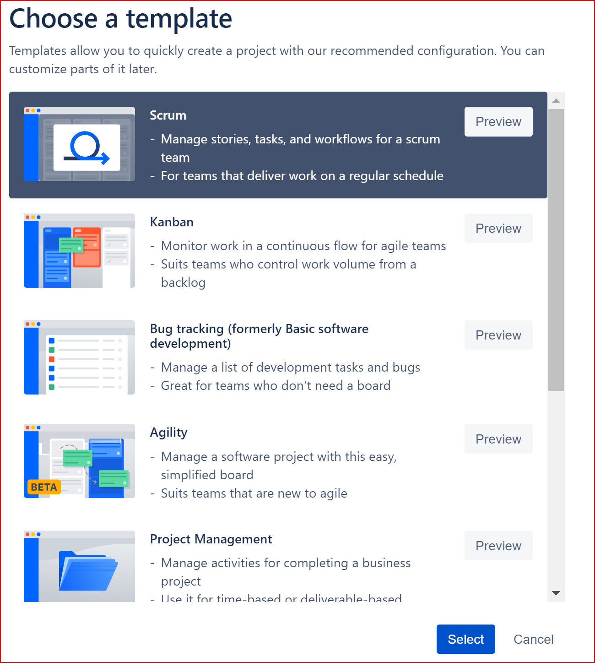

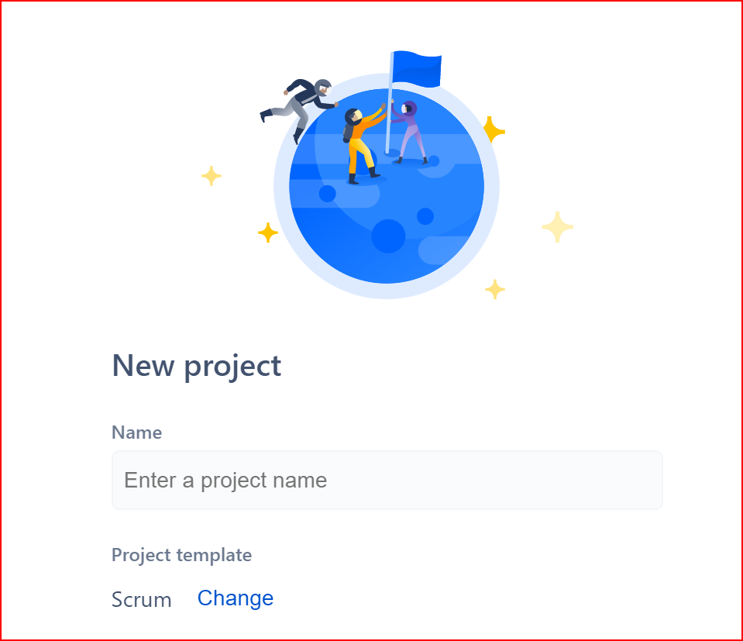
Create Scrum Project

Slide 18
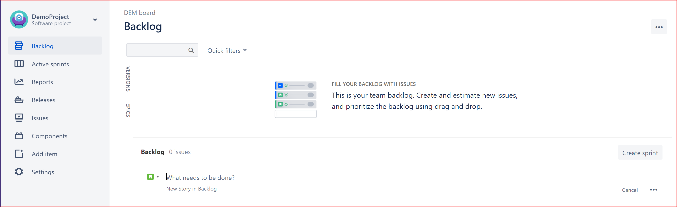
Scrum Project Agile Board (once created)

Slide 19
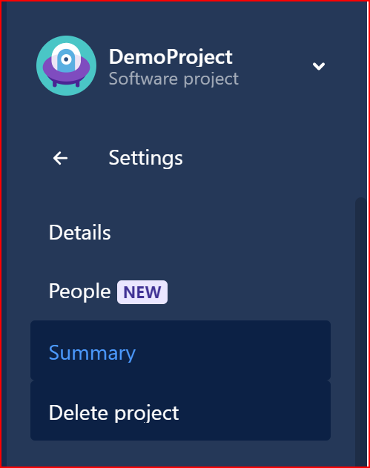
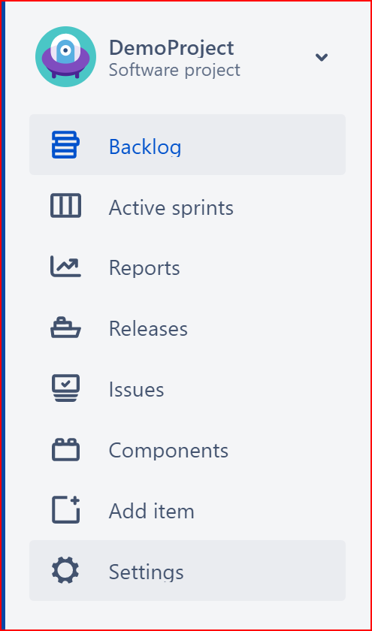
Project Configurations
Settings → Summary

Slide 20
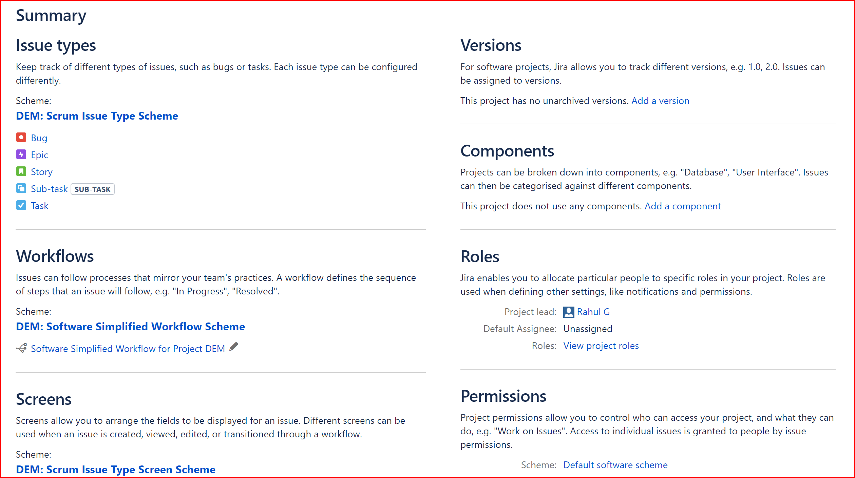
Default Project Settings

Slide 21
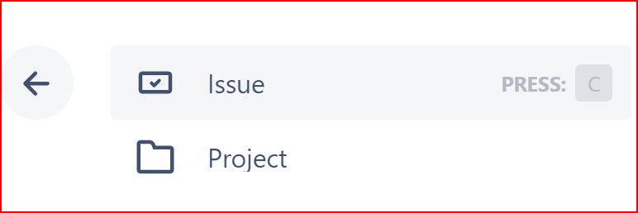
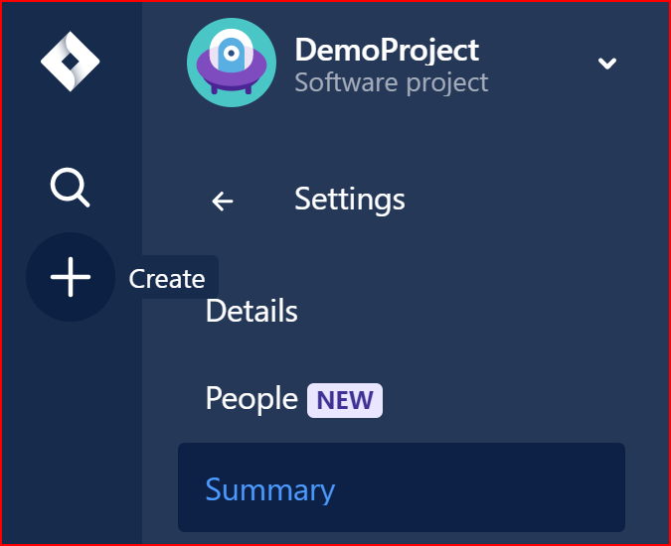
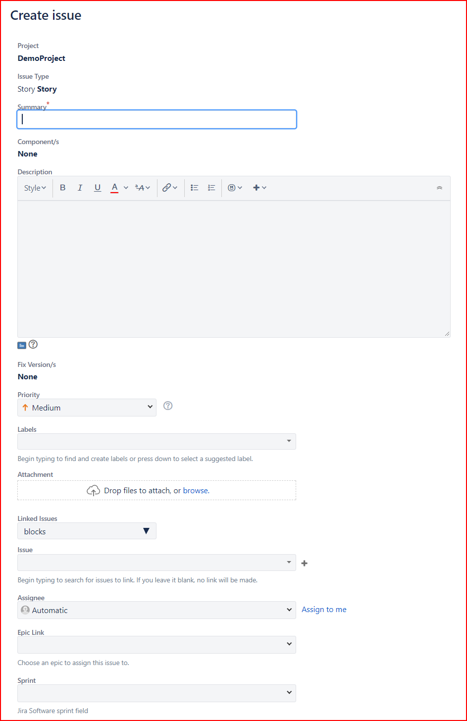
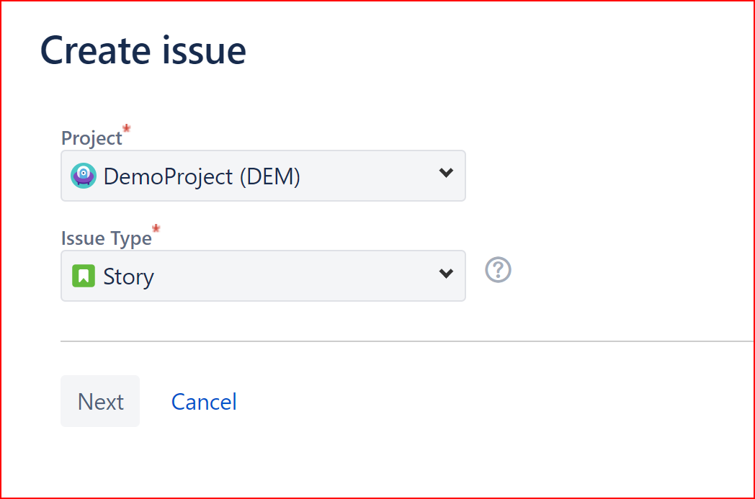
Lets create a Story

Slide 22
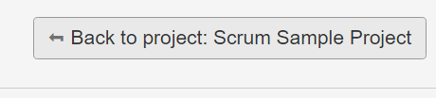
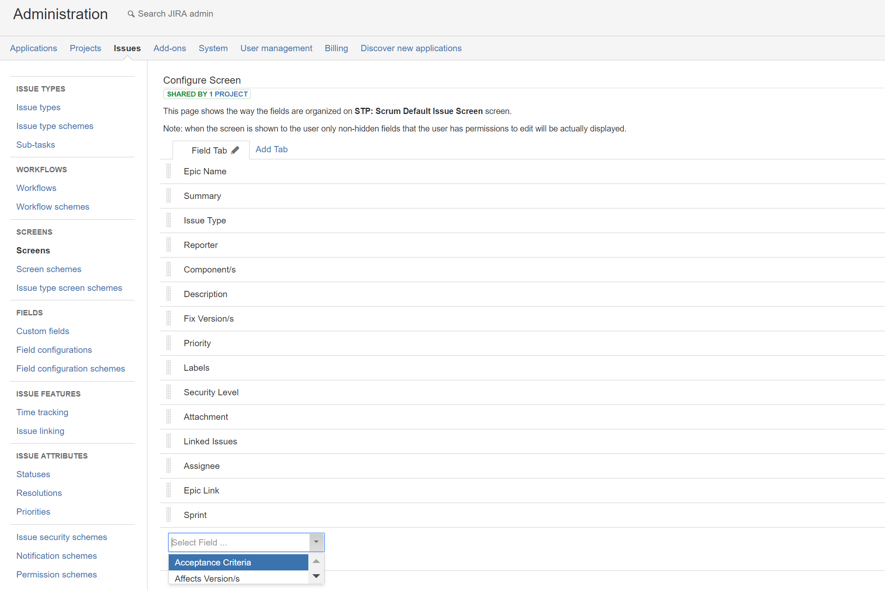
Add Acceptance Criteria Field to issue screen

Slide 23
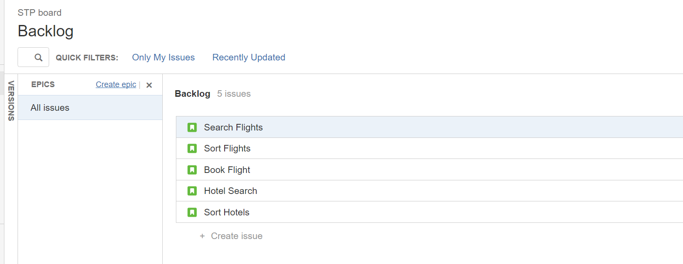
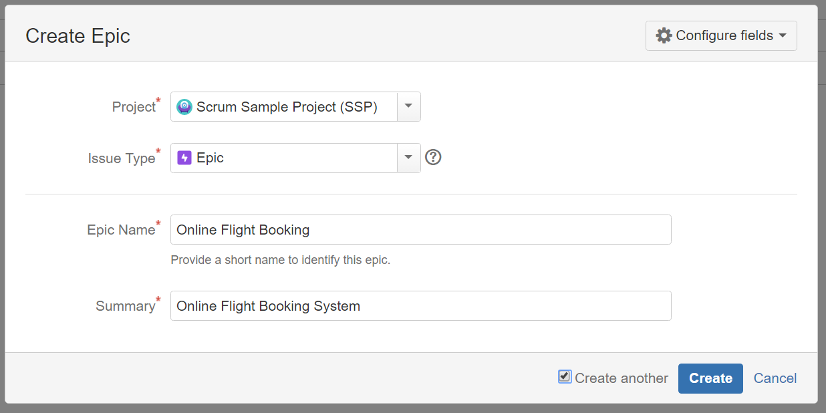
Epics
You can also create epic from “Create” on menu bar

Slide 24
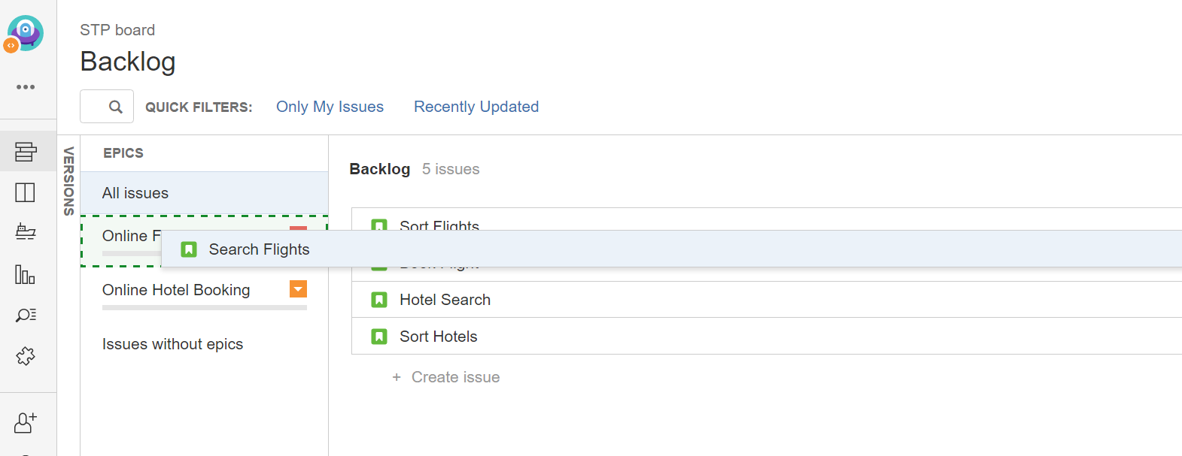
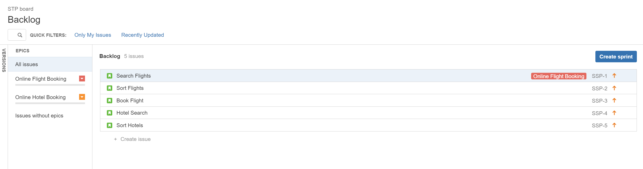
Link Stories to Epics

Slide 25
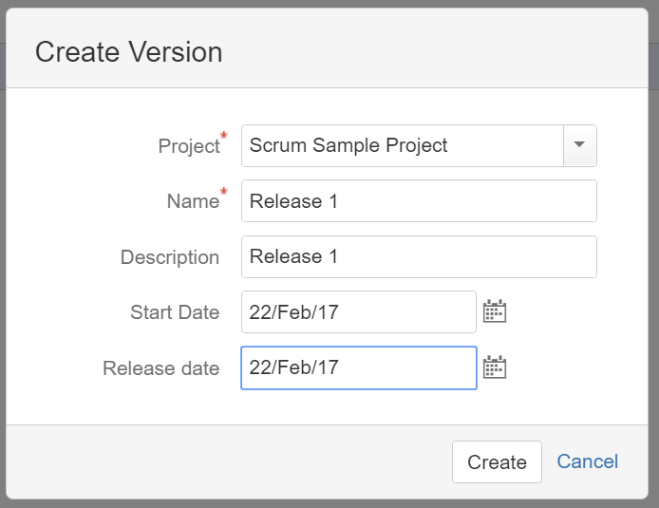
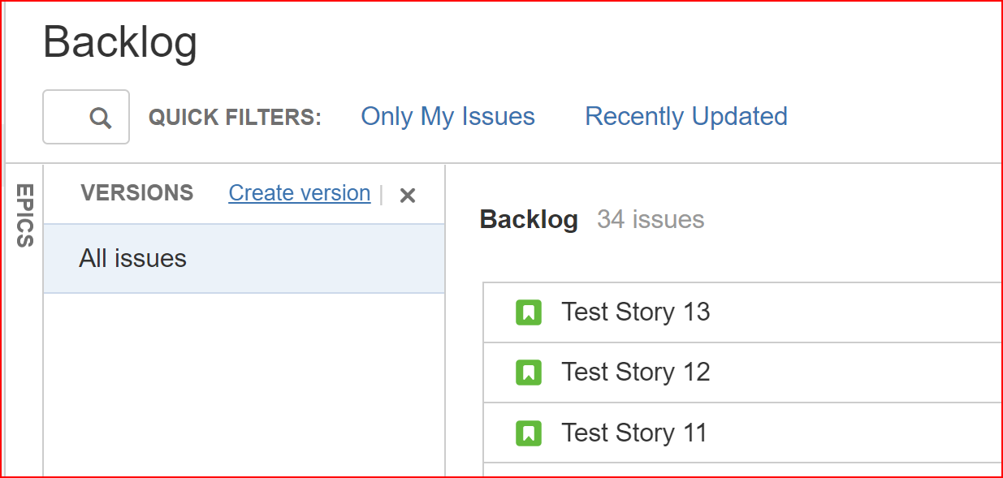
Version to create Releases

Slide 26
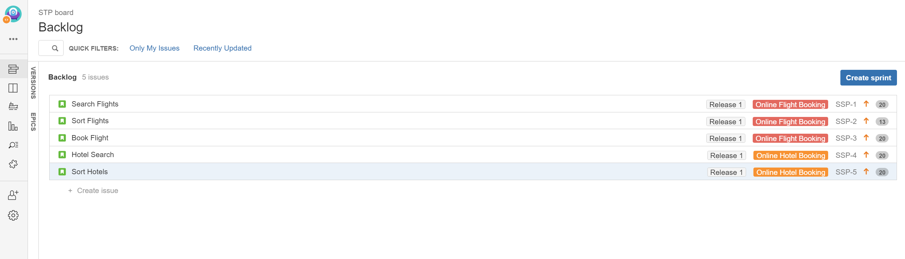
Final Product Backlog

Slide 27
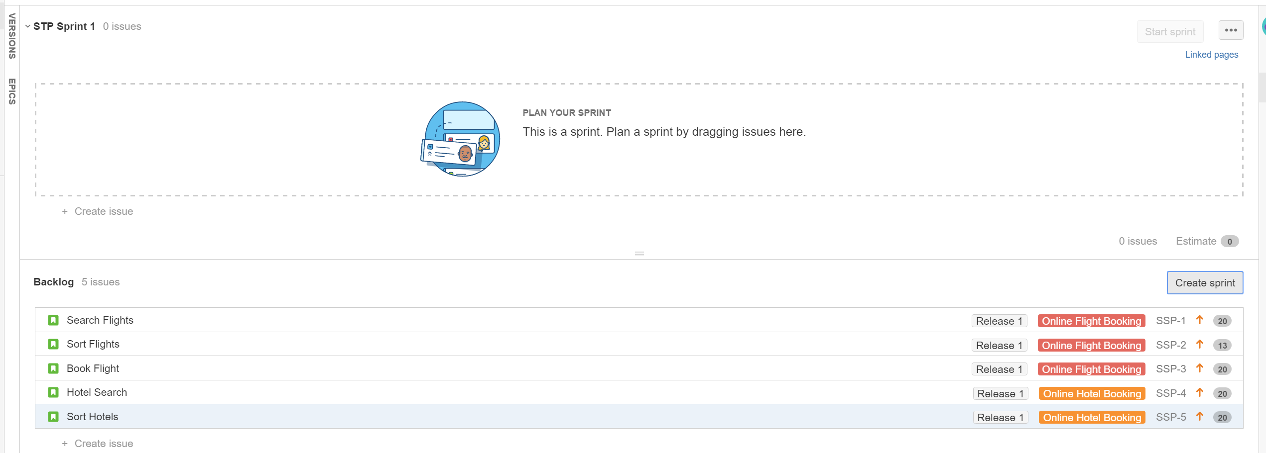
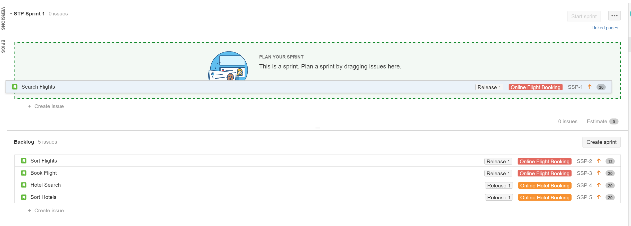
Create Sprint by drag/drop of stories

Slide 28
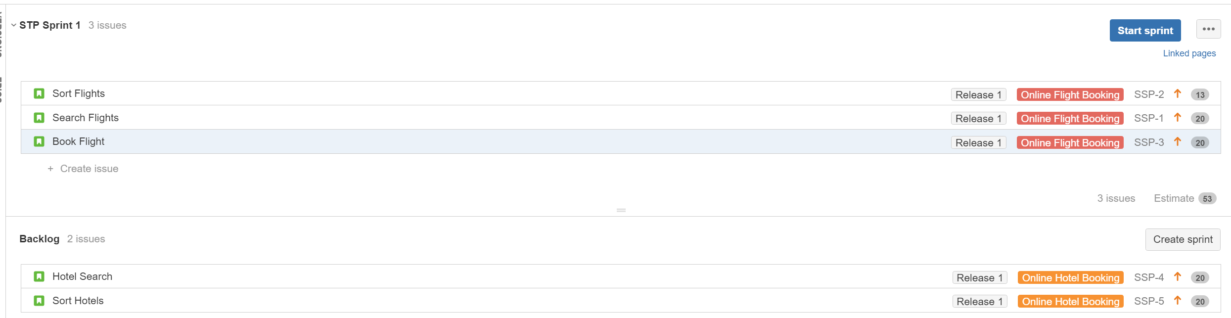
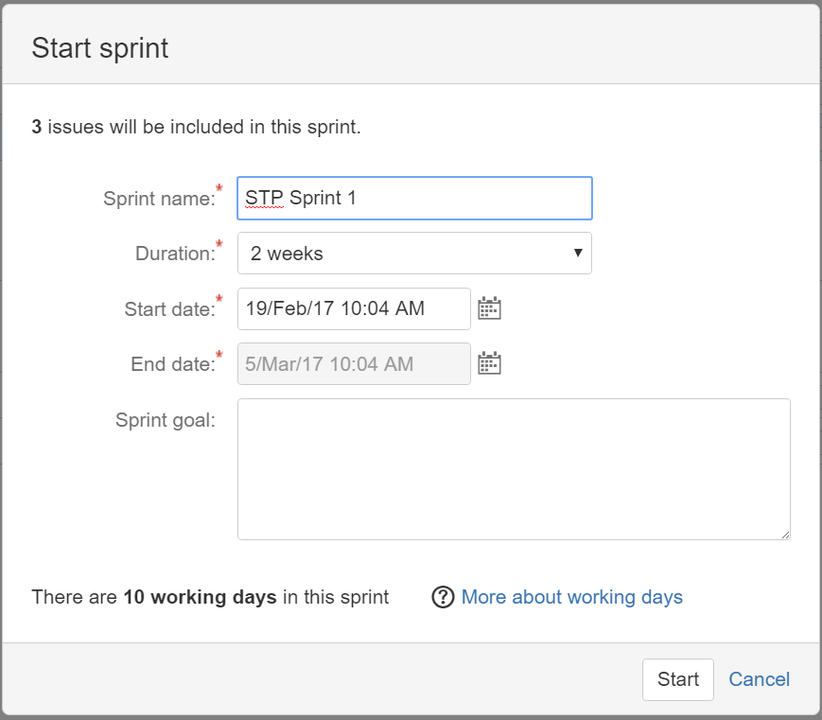
Start Sprint

Slide 29
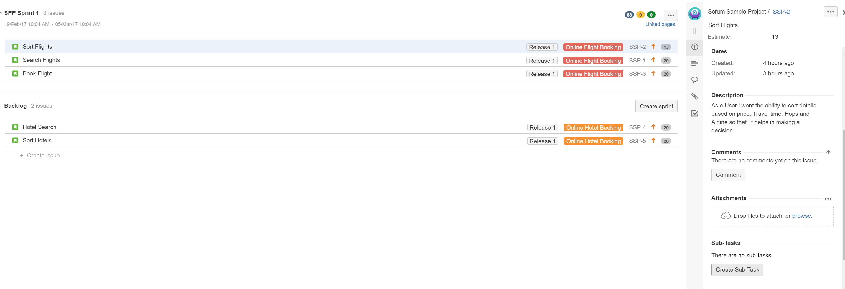
Creating sub-tasks for Stories

Slide 30
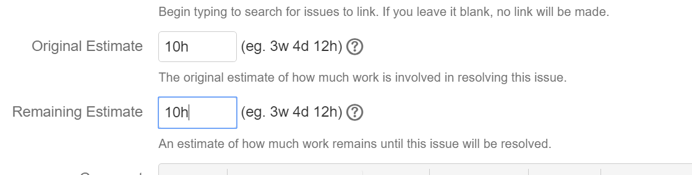
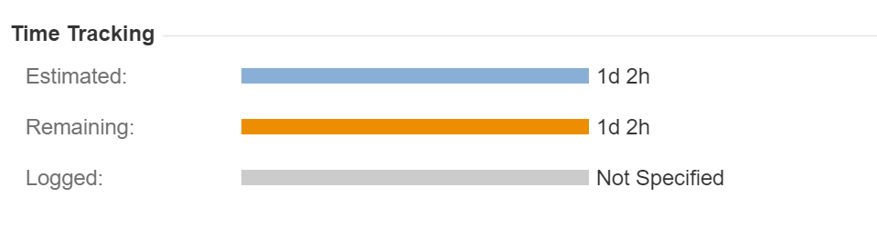
Provide Estimates for Each Task in Story

Slide 31
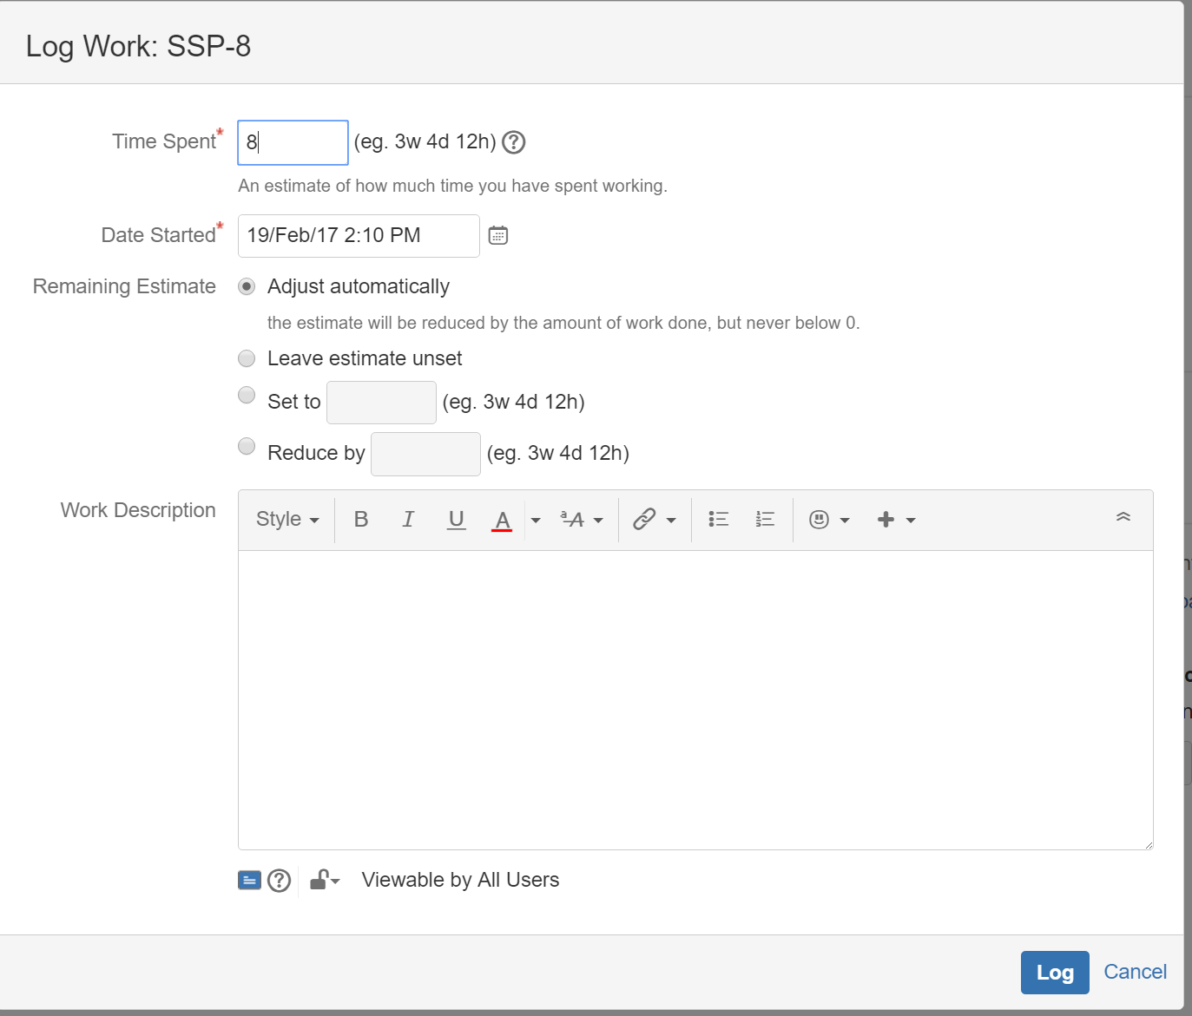
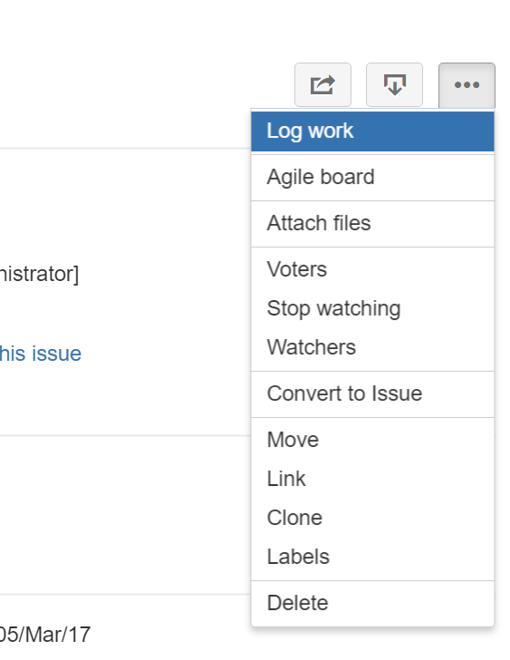
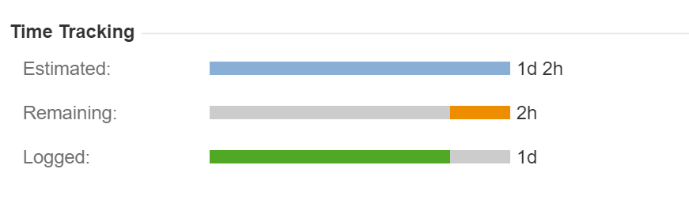
Log Work

Slide 32
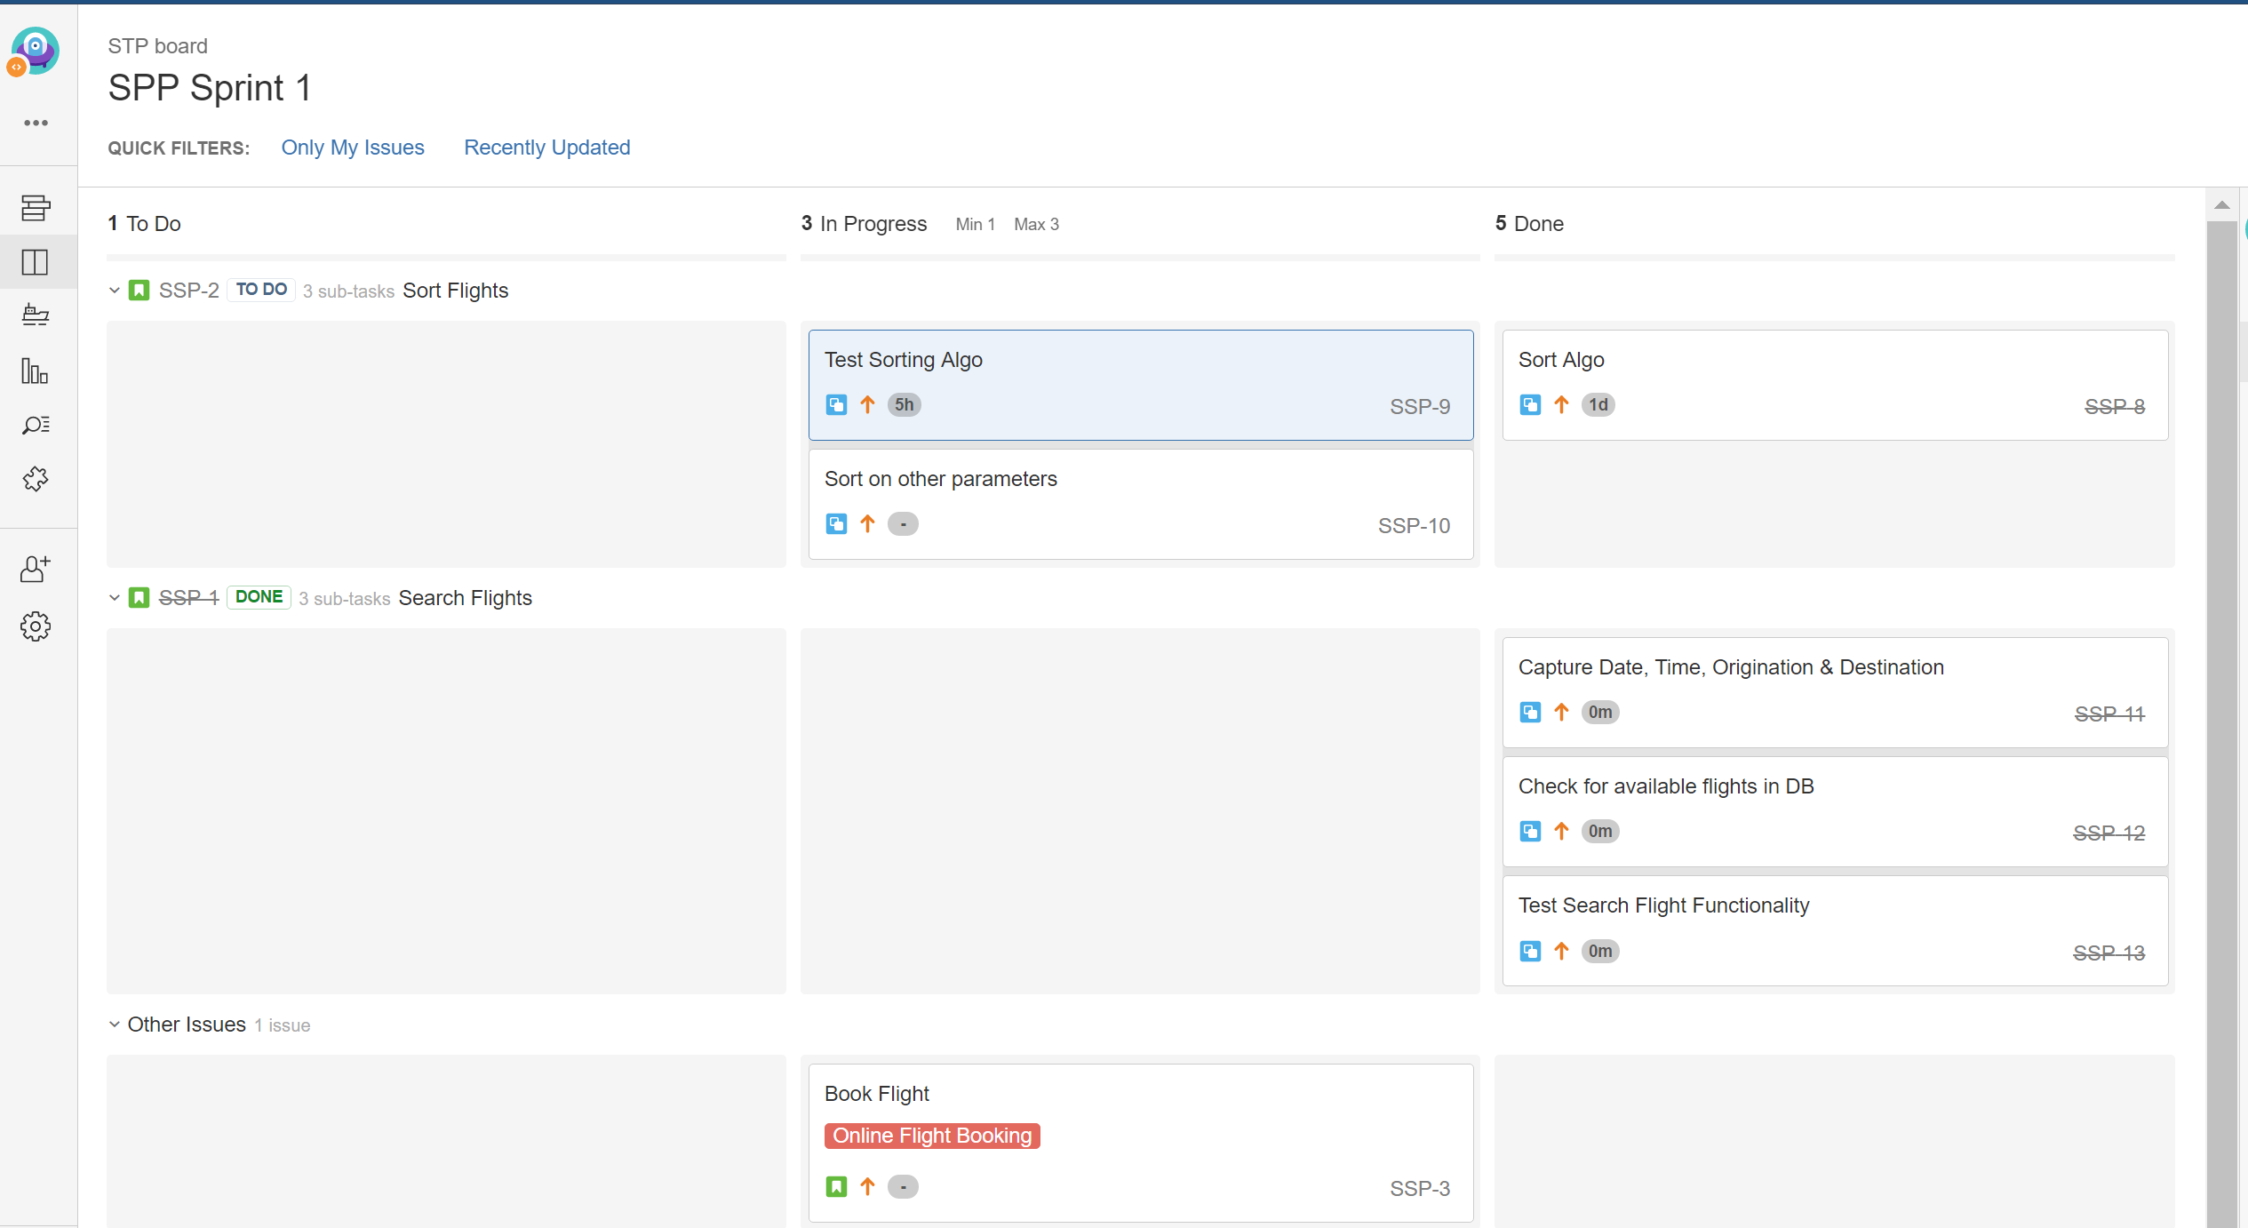
Scrum Board

Slide 33
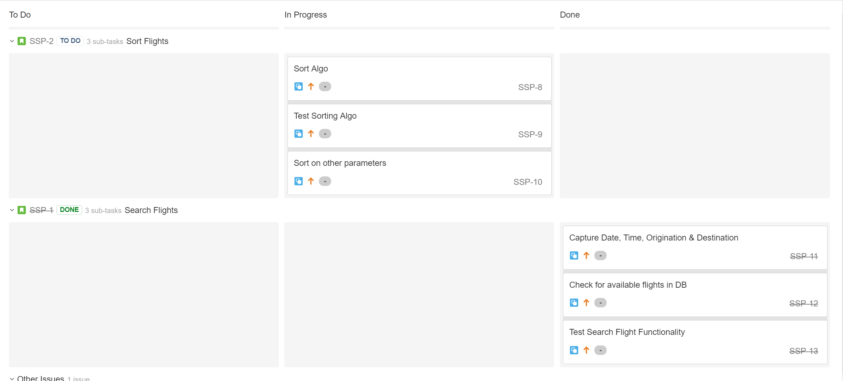
Scrum Board
Story is marked Done only when all tasks are completed

Slide 34
REPORTS

Slide 35
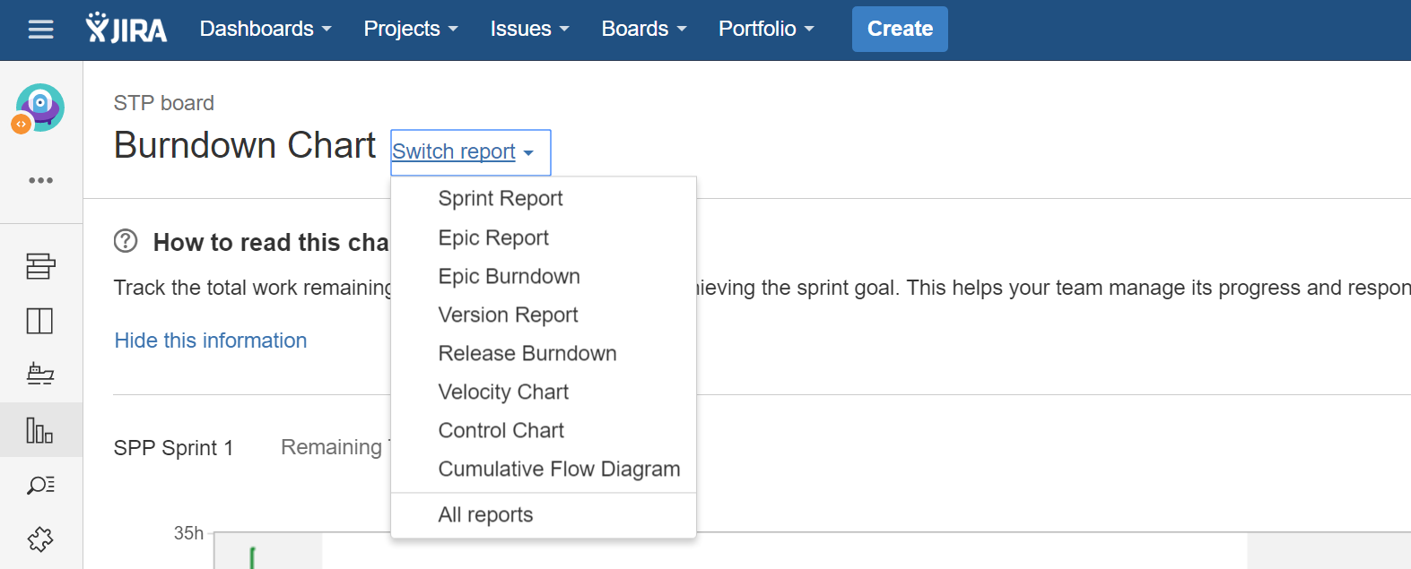
Reports

Slide 36
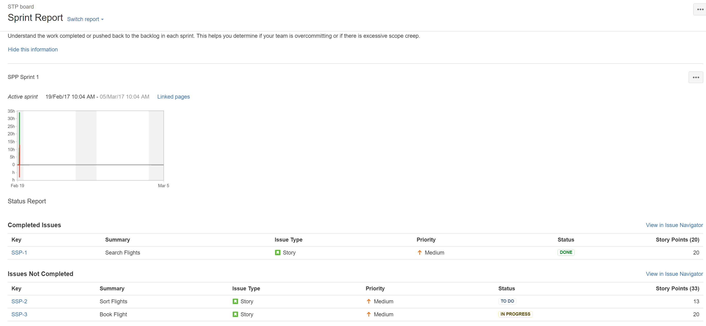
Sprint Report

Slide 37
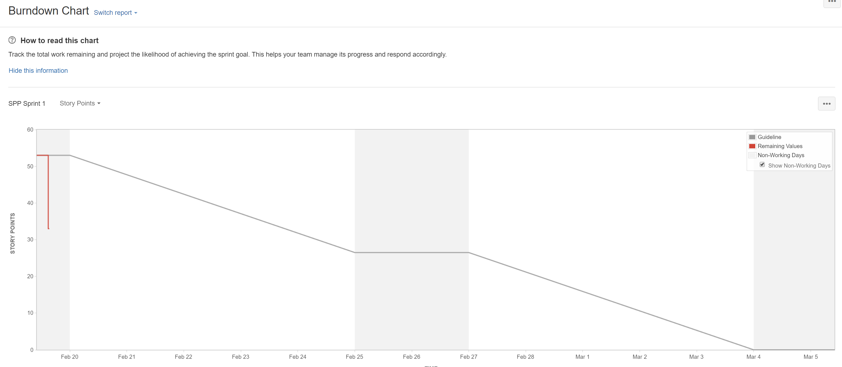
BurnDown Charts

Slide 38
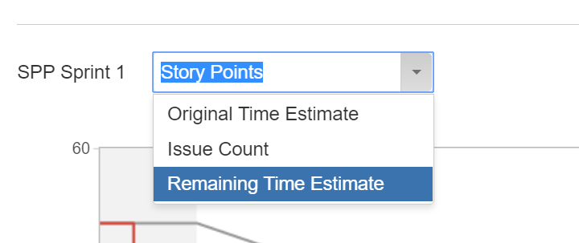
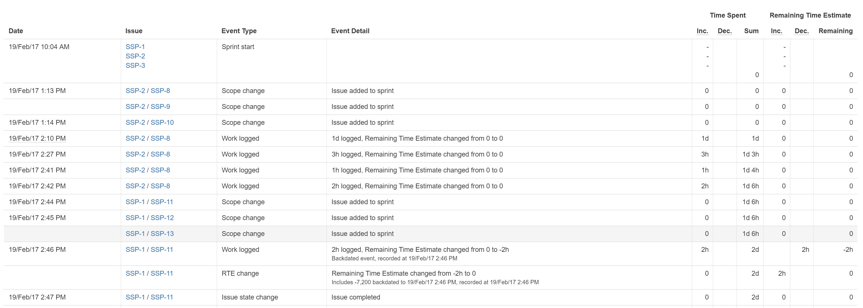
Burndown Charts (Estimates based)

Slide 39
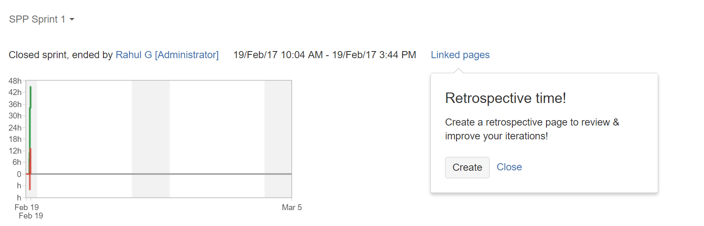
Sprint Report - Retrospectives
Need Confluence to capturing Retrospectives

Slide 40
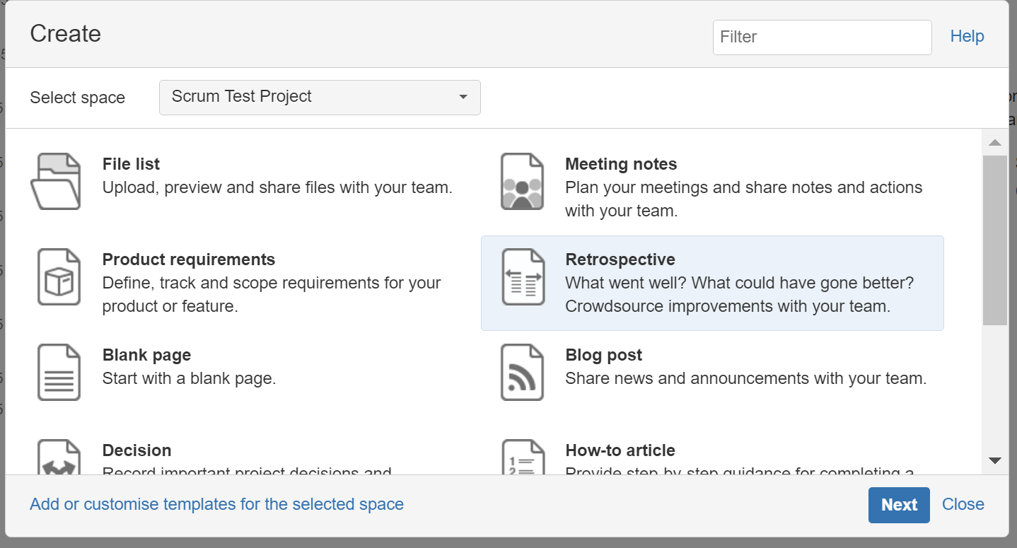
Start Retrospective (using Confluence)

Slide 41
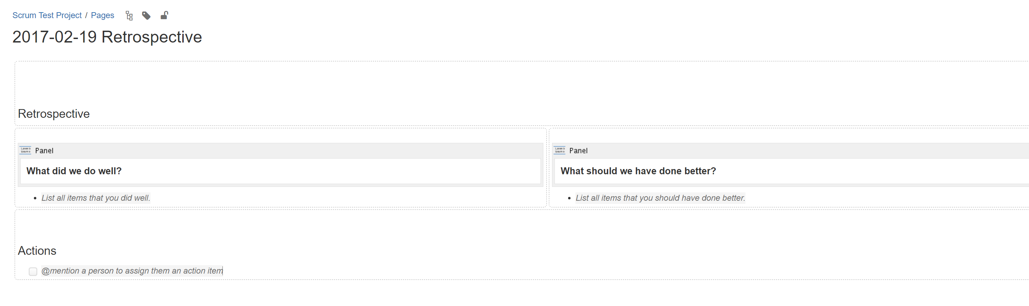
Capture Details of Retro (Confluence)

Slide 42
BUGS raised in Testing

Slide 43
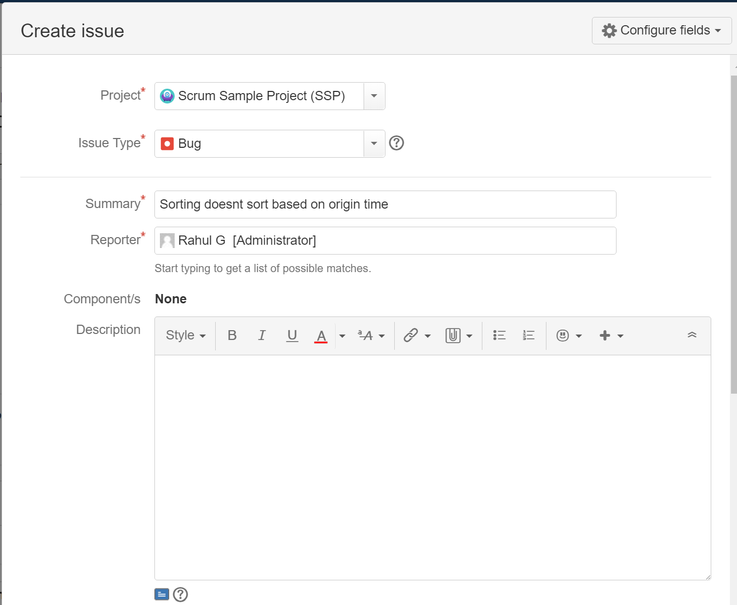

Creating Issues during Testing
Create Issue as Bug
Link Issue to Story / Task

Slide 44

Created Issue in Backlog

Slide 45


Close Sprint

Slide 46
Advanced JIRA

Slide 47
JIRA Agile: Issue Type
Standard
Epic
Story
Bug
Task
Sub-Task
Sub-Task
Agile – Needs
Spike
Technical Enablers
Feature Story
And more..

Slide 48
JIRA- Custom Fields
Standard
Story Point
Due Date
Assignee
Summary
Scrum
Acceptance Criteria
Business Value
Business / Epic Owner
And many more…

Slide 49

JIRA Statuses & Workflow
Standard
Open
In-Progress
Resolved
Closed
Re-Opened
To-Do
Done
Agile ( Scrum)
Portfolio
Funnel, Review, Analysis, Backlog, Implementation & Done
Team
Design, Dev Complete, Code Verified, Checked-In, Build Released, Test etc…

Slide 50
JIRA Priorities can be modified
Standard
Highest
High
Medium
Low
Lowest
Agile (Scrum)
Critical, Blocker, Major, Minor, Improvement/Enhancement etc..
Define Class of Service using these priorities on Kanban Boards

Slide 51

JIRA Customizations

Slide 52
WORKFLOWS

Slide 53


Standard Workflow

Slide 54

Template for Scrum Workflow

Slide 55

Scrum Project Workflow (Example)

Slide 56

Add Workflow for Scrum Projects

Slide 57

Add Scrum workflow & Publish

Slide 58
ISSUETYPES & CUSTOM FIELDS

Slide 59


Adding Issue Types
Project Setting -> Issue Types ->Actions-> Edit Issue Types -> Add Issue Type.
Also you can drag & drop Available Issue Types

Slide 60


Adding Custom Fields
Project Setting -> Fields ->Actions-> Edit Fields -> Custom Fields (left panel) -> Add Custom Field.

Slide 61



Custom Fields

Slide 62

Custom Fields
We then need to Associate field with “Projects Default Issue” Screen

Slide 63
CONFIGURE ISSUE TYPE VIEWS

Slide 64

Configure Default Issue View

Slide 65


Change Default View of Issue
Board Settings ->Estimation -> Change the Time Tracking to “Remaining Estimate and Time Spent” – This will enable time tracking and logging work in hours for each story

Slide 66

Enable Time Tracking for each Project

Slide 67

Limit WIP
v
v

Slide 68

Add Swimlanes

Slide 69
DASHBOARDS

Slide 70





Dashboards

Slide 71

Setup the Dashboard

Slide 72
SEARCHES

Slide 73



Quick Search

Slide 74



Quick Search

Slide 75




JQL Query
Operators
Keywords

Slide 76

Smart Query

Slide 77
KANBAN BOARDS

Slide 78




Kanban Boards

Slide 79


Configure Kanban Board

Slide 80

Add Swimlanes

Slide 81

Final Board after Configs

Slide 82
Tracking Releases

Slide 83

Track Releases

Slide 84

Make the Release once done

Slide 85

Release Report

Slide 86




Add-On MarketPlace

Slide 87
Thank You

